Slide 1


matlab – introduction
Lecture 6

Slide 2

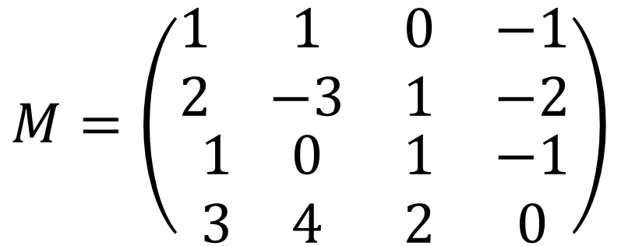
The first principle of matlab
Everything in MATLAB is a matrix/vector!!
$$M=\left(\begin{matrix}\begin{matrix}1 & 1 \\ 2 & −3\end{matrix} & \begin{matrix}0 & −1 \\ 1 & −2\end{matrix} \\ \begin{matrix}1 & 0 \\ 3 & 4\end{matrix} & \begin{matrix}1 & −1 \\ 2 & 0\end{matrix}\end{matrix}\right)$$
Row 1
$$M_{m×n}$$
Row 2
Row 3
Row 4
Col 1
Col 2
Col 3
Col 4

Slide 3
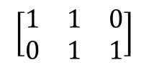
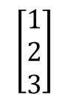
Defining various vectors/matrices in MATlab
A single number, e.g. 5
This is a 1x1 matrix
x=5
A row vector, e.g. [1,5,4,3]
This is a 1x4 matrix
x=[1 5 4 3]
$$\left[\begin{matrix}1 \\ 2 \\ 3\end{matrix}\right]$$
A column vector, e.g.
This is a 3x1 matrix
x=[1;2;3]
A proper matrix, e.g.
$$\left[\begin{matrix}1 & 1 & 0 \\ 0 & 1 & 1\end{matrix}\right]$$
This is a 2x3 matrix
x=[1 1 0;0 1 1]

Slide 4
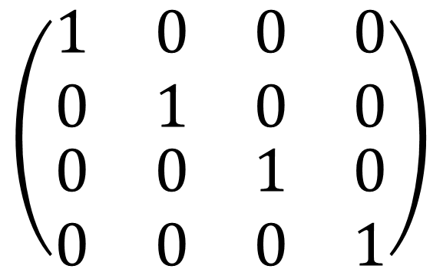
Some special matrices
zeros(m,n)
Creates a mxn matrix with entries all equal to 0
ones(m,n)
Creates a mxn matrix with entries all equal to 1
eye(n)
Creates a nxn identity matrix
$$\left(\begin{matrix}\begin{matrix}1 & 0 \\ 0 & 1\end{matrix} & \begin{matrix}0 & 0 \\ 0 & 0\end{matrix} \\ \begin{matrix}0 & 0 \\ 0 & 0\end{matrix} & \begin{matrix}1 & 0 \\ 0 & 1\end{matrix}\end{matrix}\right)$$
eye(4)=

Slide 5

Some special matrices
zeros(m,n)
Creates a mxn matrix with entries all equal to 0
ones(m,n)
Creates a mxn matrix with entries all equal to 1
eye(n)
Creates a nxn identity matrix
rand(m,n)
Creates a mxn matrix with random number entries
rand(1,5)=
$$\left(\begin{matrix}0.99 & 0.67 & \begin{matrix}0.12 & 0.18 & 0.55\end{matrix}\end{matrix}\right)$$

Slide 6
Creating equally-spaced points
X=0:2:10
X=[0 2 4 6 8 10]
X=1:0.5:5
X=[1.0 1.5 2.0 2.5 3.0 3.5 4.0 4.5 5.0]
X=10:-1:5
X=[10 9 8 7 6 5]
X=linspace(a,b,n)
Divides the interval from a to b into n-1 equal sub-interval
X=linspace(1,2,3)
X=[1 1.5 2]
X=linspace(1,2)
Divides the interval into 100 equal sub-interval

Slide 7
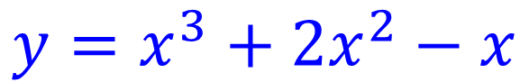
Element-wise Vector multiplication
X=[0 2 4 6 8 10]
Y=[1 3 5 7 9 11]
Z=X.*Y
element-wise multiplication
Z=[0x1 2x3 4x5 6x7 8x9 10x11]
Z=[0 6 20 42 72 110]
$${y=x}^{3}+{2x}^{2}−x$$
y=x.^3+2*x.^2-x

Slide 8
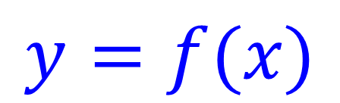
Creating plots in matlab
$$y=f(x)$$
Define the range for the x-values
Compute the range for the y-values
plot(x,y)
Always, use a MATLAB script for plotting (m-file)

